Slide 1
AIUB Personal Train Service
Group#03
Submitted by-
NAME | ID
QAYYUM, MUSHFIQ | 17-33170-1
S.M. FARDIN HOSSAIN | 17-34494-2
PULACK CHAKRABORTTY | 18-37264-1
B.M. RAHFUL HASAN SHAWON | 18-38270-2

Slide 2
INTRODUCTION
Our project is about a train service provided by AIUB authorities to ensure the safety and comfort of the student’s journey from their residence to AIUB campus and vise versa. There will be a junction named after AIUB which will be located at the main gate of the campus.

Slide 3



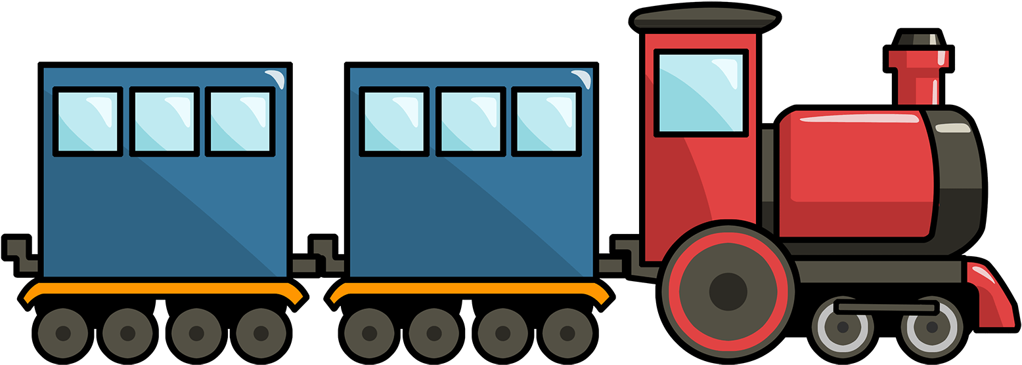
OBJECTS
There are several objects has been used into the project:
Students
Bridge
Train
Rail line
River
Station
Tree
Sun
Moon
Clouds
Stars
Land

Slide 4
SCENARIOS
Running train
Train stops at the station
Train parked at the station at night

Slide 5
FUNCTIONS OF SOME KEY OBJECTS
train();
text();
text1();
cloud1();
cloud2();
sun();
moon();
bridge();
station();

Slide 6

ANIMATIONS
Train moving animation
Cloud moving animation
Day to night transition

Slide 7
INTERACTIVE FUNCTION
handleKeyPress(unsigned char key, int x, int y)

Slide 8
IMPROVEMENTS
There could have been few more objects and animations to improve the project.
Students moving at station
Bus on the road
Boat in the river
Plane in the sky
Birds in the sky
Blinking signal light at station

Slide 9
CONCLUSION
This project gives us a visual structure of the personal transportation system of AIUB. We can realize from the project that the importance of personal transport of AIUB. It also shows us a draft plan on implementation of the transportation system.

Slide 10
Thank you

